Slide 1
Network economics: the hardware/software paradigm, winner-takes-all-markets and technological standard wars_3
Luca Grilli
L. Grilli, Politecnico di Milano –Network economics

Slide 2
Strategic choice between compatibility and incompatibility

Slide 3
COMPATIBILITY or NON COMPATIBILITY: this is the question
First of all, let us define compatibility (interoperability):
2 products are defined compatible if they “can work together”. If this is the case we say that different brands adopt the same standard. In the opposite case, we say that products are incompatible.
There is downward compatibility when a new release of a product is compatible with the old one, but it is not the other way around (example Windows Office).
A product is “one-way compatible” if it can work together with the output of a rival brand, but it is not the other way around (example: historically it was Linux vs. Windows, now with WSL compatibility has increased).

Slide 4
In order to better understand the consequences of the strategic choice (comp. Vs non-comp.) let us focus on the characteristics of a network market
The success of a standard will depend on its capacity to solve the start-up problem (i.e. attract the critical mass) and trigger the bandwagon effect
Observations
If there is competition between firms (non-compatibility)
Network Markets “naturally” tends to monopoly
Choices of early adopters are fundamental and can determine the victory of a standard against the other standards (so early stages are extermely important for firms)
First mover advantage

Slide 5
Formally (see Farrell and Saloner 1986, EL; Cabral IO)
2 incompatible goods: A and B.
Population (N =1) is formed by agents who prefer A (a) and agents who prefer B (b) with a+b=1.
Utility of a: v(x) if buy A and v(x) – α if buy B
Utility of b: v(x) if buy B and v(x) – α if buy A
Let us suppose that market is perfectly competitive so firms charge the same price.
[Also suppose that being the only one to acquire the good will bring a zero benefit, in that case monopoly will be an equilibrium if v(1) – α ≥ 0].
Now suppose a sequential entry of consumers into the market.
Consumers b will buy A only if v(a) – α > v(b) and Consumers a will buy B only if v(b) – α > v(a).

Slide 6
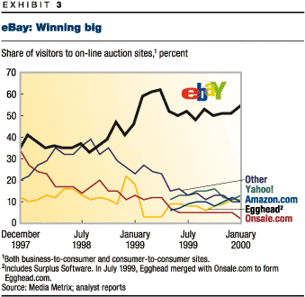
The achievement of a critical mass in a standard war
v(a) – v(b)
α
Lock-in in A
0
α
v(b) – v(a)
1)
We can characterize that “tipping point”: we can either say that eBay was able to reach the critical mass before competitors or the first to achieve the “technological absorbing barrier” and lock the market

Slide 7
The achievement of a critical mass in a standard war
v(a) – v(b)
α
Lock-in in A
0
α
v(b) – v(a)
2) Early adopters are more important (for reaching the critical mass) the higher are the network externalities (high v’) and the lower is the love for variety (low α).
3) Same logics applies to the first mover advantage.

Slide 8
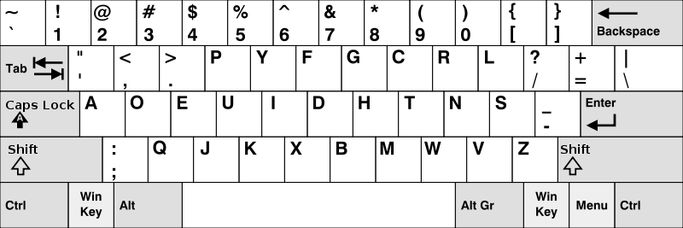

Remark: the model also makes self-evident the risk that an inferior technology could emerge as winner of a standard war.
See also Katz and Shapiro (1986). Technology Adoption in the Presence of Network Externalities. Journal of Political Economy, 94, 822-841.
This is a real possibility from a theoretical point of view, but (luckily enough) on an empirical ground is very difficult to affirm that such risk has ever become reality.
One possible interesting case is Quadrophonic sound (RCAs vs. Columbia) in the 1970s that did not replace stereo sound (Postrel, 1990, JIE). Among others (e.g. digital compact cassettes by Philips), the most famous (still controversial) case is for sure the one of Qwerty vs Dvorak .
-David, P., “Clio and the Economics of QWERTY,” American Economic Review (75), 1985, 332-337.
-Liebowitz, S., and S. Margolis, “The Fable of the Keys,” Journal of Law and Economics (33), 1990, 1-25.

Slide 9
QWERTY vs DVORAK
Questionable whether there was path dependent inefficiency or not………..less questionable is the fact that the process has shown a higher degree of path dependency since we are adopting this system invented 150 years ago.
QUESTION(S): WHY A KEYBOARD IS A NETWORK GOOD? AND OF WHAT TYPE?

Slide 10
2 forces may spur standardization
Firms have often to bear high costs in R&D to develop their network good and in large measure they are sunk because highly specific.
Firms have to incur in high marketing expenditure (again of some sunk nature) and coordination with complementors can also be extremely costly when a firm choose incompatibility and opt for a go-it-alone strategy
So it is not unusual that in network markets standards are defined through international “public” organizations [e.g. UL or NIST in the USA, similar institute(s) in EU, like ETSI (which is becoming more global), more “global” like ITU or 3GPP) or alliances between firms (“coopetition logic”). Or firms choose an “open standard” policy (very low licensing fees for the patented technology they developed). [See the Appendix for a thorough analysis of the “open” vs. “closed” standard strategy].

Slide 11
COOPETITION
COLLABORATION
upstream
COMPETITION
downstream
E.g. DVD (Sony, Toshiba, Panasonic, Warner, Columbia).
E.g. Open Mobile Alliance (now OMA SpecWorks) [Both “hardware” (Mobile operators) and “software” companies (Application & Content Providers) for standard setting in Mobile telecom. Some members (+200): Ericsson, NTT Docomo, Vodafone, AT&T, China Telecommunications, Verizon, Motorola, Telecom Italia, Microsoft, Intel, Softbank Mobile, etc. )]. The alliance developed WAP for GSM mobile phones or XHTML Mobile Profile for smartphone, among other technologies/protocols.
E.g. Open Handset Alliance (84 technology and mobile companies led by Google for developing Android).
E.g. Bluetooth Special Interest Group (SIG) ( From Leiponen (2023), Digital Innovation Strategy: ”founded in 1998 by five companies: Ericsson, IBM, Intel, Nokia, and Toshiba. The short-range radio technology originated from Ericsson, but the company decided to open it up using this industry forum to collaboratively maintain and further develop the technical specifications”).

Slide 12
The logic of open standard through a game-theoretic approach (Grindley 1995, Pepall et al. 2009)

Slide 13

a) Battle of the sexes game
A\B | Lead | Follow
Lead | (3,3) | (6,4)
Follow | (4,6) | (0,0)
2 Nash Equilibria
Result: Both firms will prefer to cooperate rather than fight each other
b) The rather fight than switch game
A\B | Lead | Follow
Lead | (3,3) | (8,2)
Follow | (2,8) | (0,0)
1 N. E.
Result: Both firms prefer to fight rather than cooperate

Slide 14
The equilibrium of the first game Pareto dominates the equilibrium of the second game
The difference between the two games stems from the greed for profit of the firm that develops the standard
Lesson:
This is an example in which firms’ are better off if are cooperative or not to greedy. Firms can switch from the second to the first game if the leading firm:
- Set very low licensing fees (policy of open standard)
- Reduce absorption costs of the follower (in knowledge-intensive sectors these may be large, e.g. The Micronas case, in Appendix 2 of the video lecture on Transaction costs).

Slide 15
More generally, the strategic choice “compatibility vs non-compatibility” implies the following trade-off:
If a firm manages to reach the critical mass (success), it gets all the big pie
NO COMP
Prob. Of success
Lead and closed standard
(possible result: a big slice of a small pie, high risk of network failure)
High competitive pressure
COMP
Prob. of success
Lead and open standard
(possible result: a small slice of a big pie, more probabilities that the standard will reach the critical mass: high confidence by the agents, low risk of lock-in by potential consumers, low uncertainty by complementors)

Slide 16
CASES ON STANDARD WARS
(first part)

Slide 17
Arthur (1996), Harvard Business Review (“Increasing returns and the new world of business”)
It is casino gambling,where part of the game is to choose which games to play, as well as playing them with skill. We can imagine the top figures in high tech—the Gateses of their industries—as milling in a large casino. Over at this table, a game is starting called multimedia. Over at that one, a game called Web services. In the corner is electronic banking. There are many such tables. You sit at one.
How much to play? you ask. Three billion, the croupier replies. Who’ll be playing? We won’t know until they show up. What are the rules? Those’ll emerge as the game unfolds. What are my odds of winning? We can’t say.
Do you still want to play? High tech, pursued at this level, is not for the timid.
In fact, the art of playing the tables in the Casino of Technology is primarily a psychological one. What counts to some degree—but only to some degree—is technical expertise, deep pockets, will, and courage. Above all, the rewards go to the players who are first to make sense of the new games looming out of the technological fog, to see their shape, to cognize them. Bill Gates is not so much a wizard of technology as a wizard of precognition, of discerning the shape of the next game.

Slide 18
Rohlfs, 2003, 2003, Bandwagon effects in high-technology industries, p. 45: [in the case firms choose NO COMP, the most rationale strategy] “may be to signal an irrational commitment to win the race (of the standard) at all costs. This is analogous to a well-known result of oligopoly theory; namely, the most rational strategy for an oligopolist may be to signal an irrational strategy commitment to punish price cutters-regardless of the ruinous cost that it may incur by doing so.”
Factors that can positively influence the standard war
Size
Financial resources
Commercial strength (marketing and distribution channels)
Brand and reputation
The IBM-APPLE case testifies that these factors matter, the VHS-Betamax case are an example of how a small firm can beat a big company

Slide 19
1) VHS VS Betamax
PREMISE
1970 Partnership between Sony, JVC/Matsushita for developing a prototype of VCR for scientific purposes (U- Matic on a patent-sharing agreement).
IMPORTANT DATES
1975 Launch of Betamax (Sony) in the U.S.
1976 Launch of VHS in the U.S (JVC/Matsushita and other partners)
1988 Sony adopted standard VHS

Slide 20
Standard war: VHS vs. Betamax
Characteristic | Year | VHS | Betamax
Playing time | 1975 |  | 1 h
 | 1976 | 2 h
 | 1977 | 4 h | 2 h
Programming delay | 1977 | 24 h
 | 1978 | 7 days
 | 1982 | 15 days | 15 days
Video quality |  |  | higher
Size & weight | 1977 | 46x32x16cm, 13,5 kg | 53x12x19 cm, 19,2 kg
Other characteristics | 1978 | Fast/Slow Motion
 | 1983 | Hi-fi Audio

Slide 21
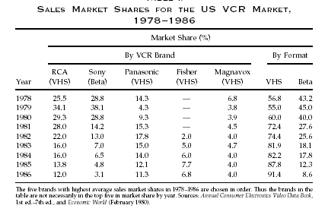
VHS vs Betamax

Slide 22
REFERENCE
(for case study)
VCR: J. H. Rohlfs, 2003, Bandwagon effects in high-technology industries, MIT, Boston, Chapter 10.

Slide 23
ESSENTIAL REFERENCES
(for this and upcoming lectures on network economics)
L. Cabral, Introduction to Industrial organization, I edition, 2000, Chapter 16.
J. H. Rohlfs, 2001, Bandwagon effects in high-technology industries, MIT, Boston, Chapters 3,4,5.
Additional:
C. Shapiro e H. R. Varian, 1999, Information rules, ETAS Libri
Peter Grindley, 1995, Standards, Strategy, and Policy,Cases and Stories, Oxford University Press.
L. Cabral, Introduction to Industrial organization, II edition, 2018, Chapter 16.

Slide 24
APPENDIX
Strategic positioning decisions
(Grindley 1995)

Slide 25
4 Strategies
Sponsor/defend: development of a standard and restriction of the use towards concurrent firms (high licensing fees)
Give away: possibility for the concurrent firms to use the standard without restriction or with low licensing fees
License in: use of a standard developed by another firm
Clone: use of an open standard without restriction
 | Closed std | Open std
Lead (development) | SPONSOR/DEFEND | GIVE AWAY
Follow (adoption) | LICENSE IN | CLONE

Slide 26
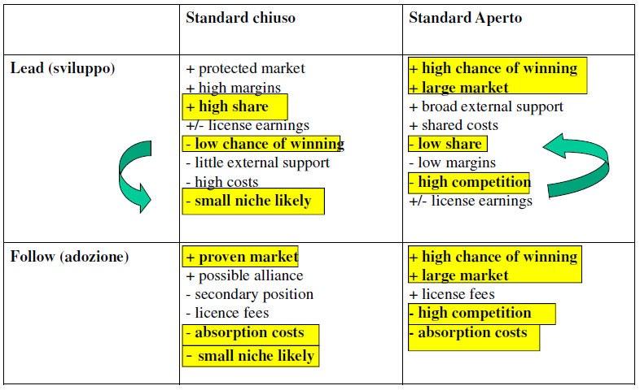
4 Strategies “pros” and “cons”
Closed standard
Open standard
Strategic positioning: costs and benefits
Lead
Follow
26

